Slide 1

RESUME BUILDER WEBSITE
TEAM ALPHA

Slide 2
MINOR PROJECT
STUDENT NAME SUPERVISOR NAME
AKSHITA SHARMA 20BCON140 MR.S NIDHI GAUR
PRISHITA 20BCON138
KRITIKA AGARWAL 20BCON236
AKANKSHA CHOUDHARY 20BCON99

Slide 3
PRESENTATION OUTLINE
INTRODUCTION TO PROJECT
TECHNOLOGY USED
EXISTING GAPS & PROJECT FEATURES
OBJECTIVES
SCOPE/RECOVERY
OUTPUT
CONCLUSION & FUTURE ASPECTS

Slide 4
TEAM ALPHA RESUME
Team alpha has developed the perfect non writer’s resume tool.
It is the simplest and most effective resume tool to build resume for professionals as well as for non professional job seeker’s. Various customisations according to user is also available .

Slide 5
TECHNOLOGY USED
HTML
CSS
JAVA SCRIPT
BOOTSTRAP
PYTHON
PHP
MYSQL

Slide 6
FEATURES
Step by step for foolproof resume building.
Easy edit feature.
Easy to modify ready made statements.
Easy to understand resume template.
Attractive template to make resume look professional.
Customisation available.
Half prepared resume gets stored inside our servers.
Easy to store and manage.

Slide 7
FEATURES
Highly customisable.
Easy to share.
Downloadable to text and pdf.
Data and privacy control.
Manage multiple resume.

Slide 8
ANALYSIS AND FEATURE

Slide 9
It is an application that simplifies the task of creating a resume for individuals. The system is flexible to be used and reduces the need of thinking and designing an appropriate resume according to qualifications. The system is developed to provide easy means for creating a professional looking resume. Individuals just have to fill up a form that specifies questions from all required fields such as personal questions, educational qualification. Interest, skills and so on. The answers provided by the users are stored and the system automatically generate a well structured resume. Users have option to create resume in any format or file.

Slide 10
OBJECTIVES

Slide 11
The main objective of the online resume builder is to manage the details of resume, job, individual, skills, qualification. It manages all the information about resume, jobseeker, qualification, resume. The project is totally built at administrative end and thus only the administrator os generated the access. You will develop a web application that will auto-generate a note and properly formatted resume from the task information filled up form. Project context creating a resume is a bit tedious tsk for any working professional form any individual. One has to keep it short and simple. Over a while, this project will help you through the process that can be followed to build your resume builder using css and JS. Implementing the project will give you the satisfaction of auto-generating it on your own.

Slide 12
SCOPE
Resume can also be classified according to different branches and for specific companies.
For example : If someone has more practical experience and less CGPA/Percentage and resume should emphasis on project of the project more.

Slide 13
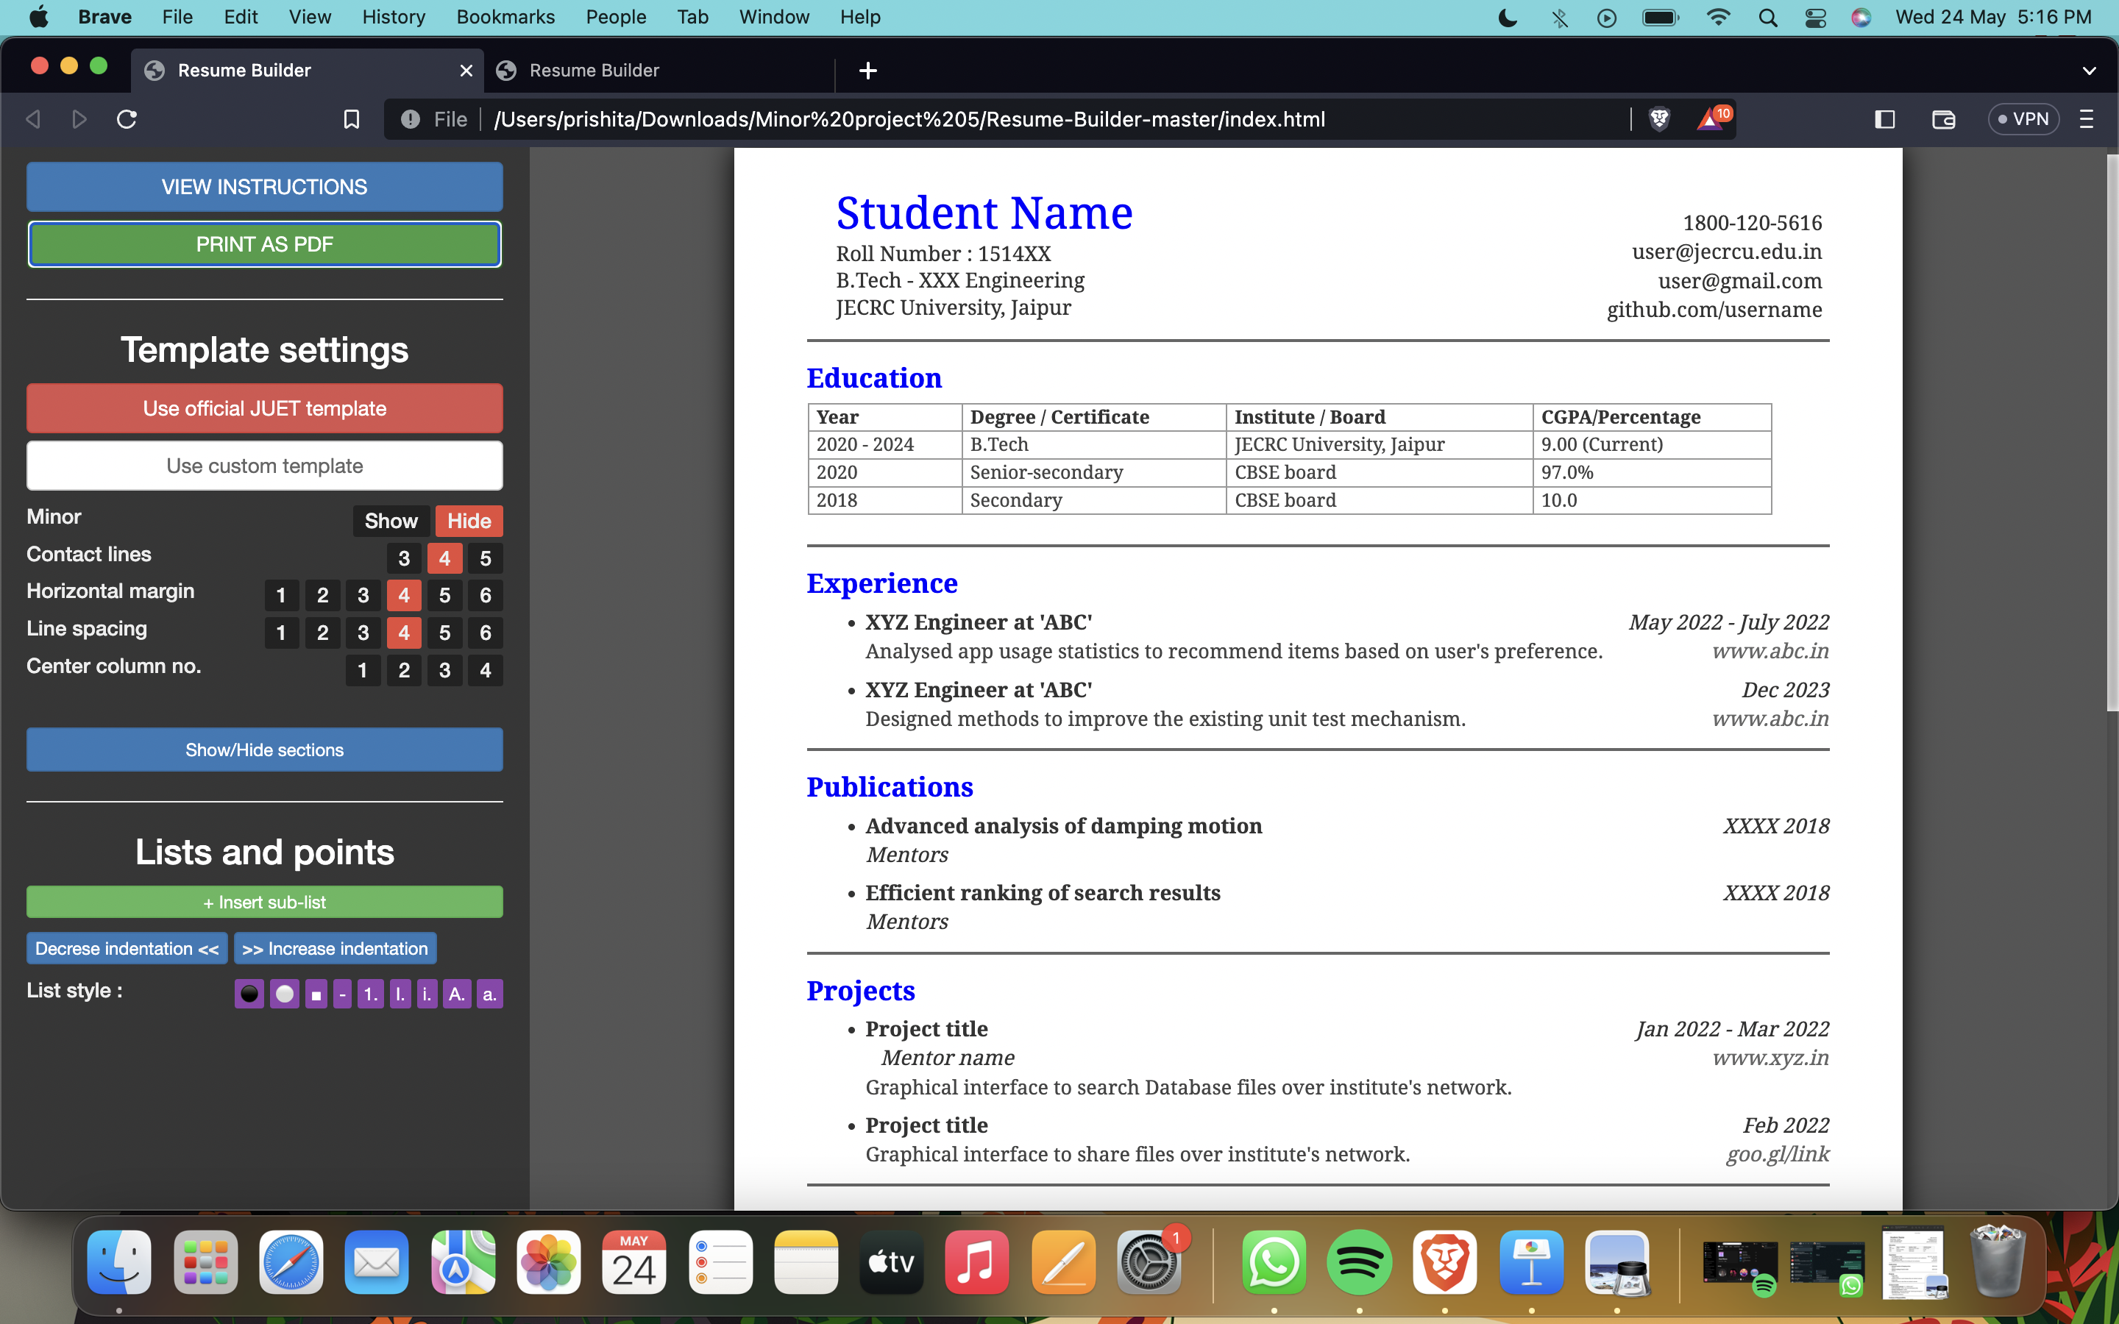

Slide 14
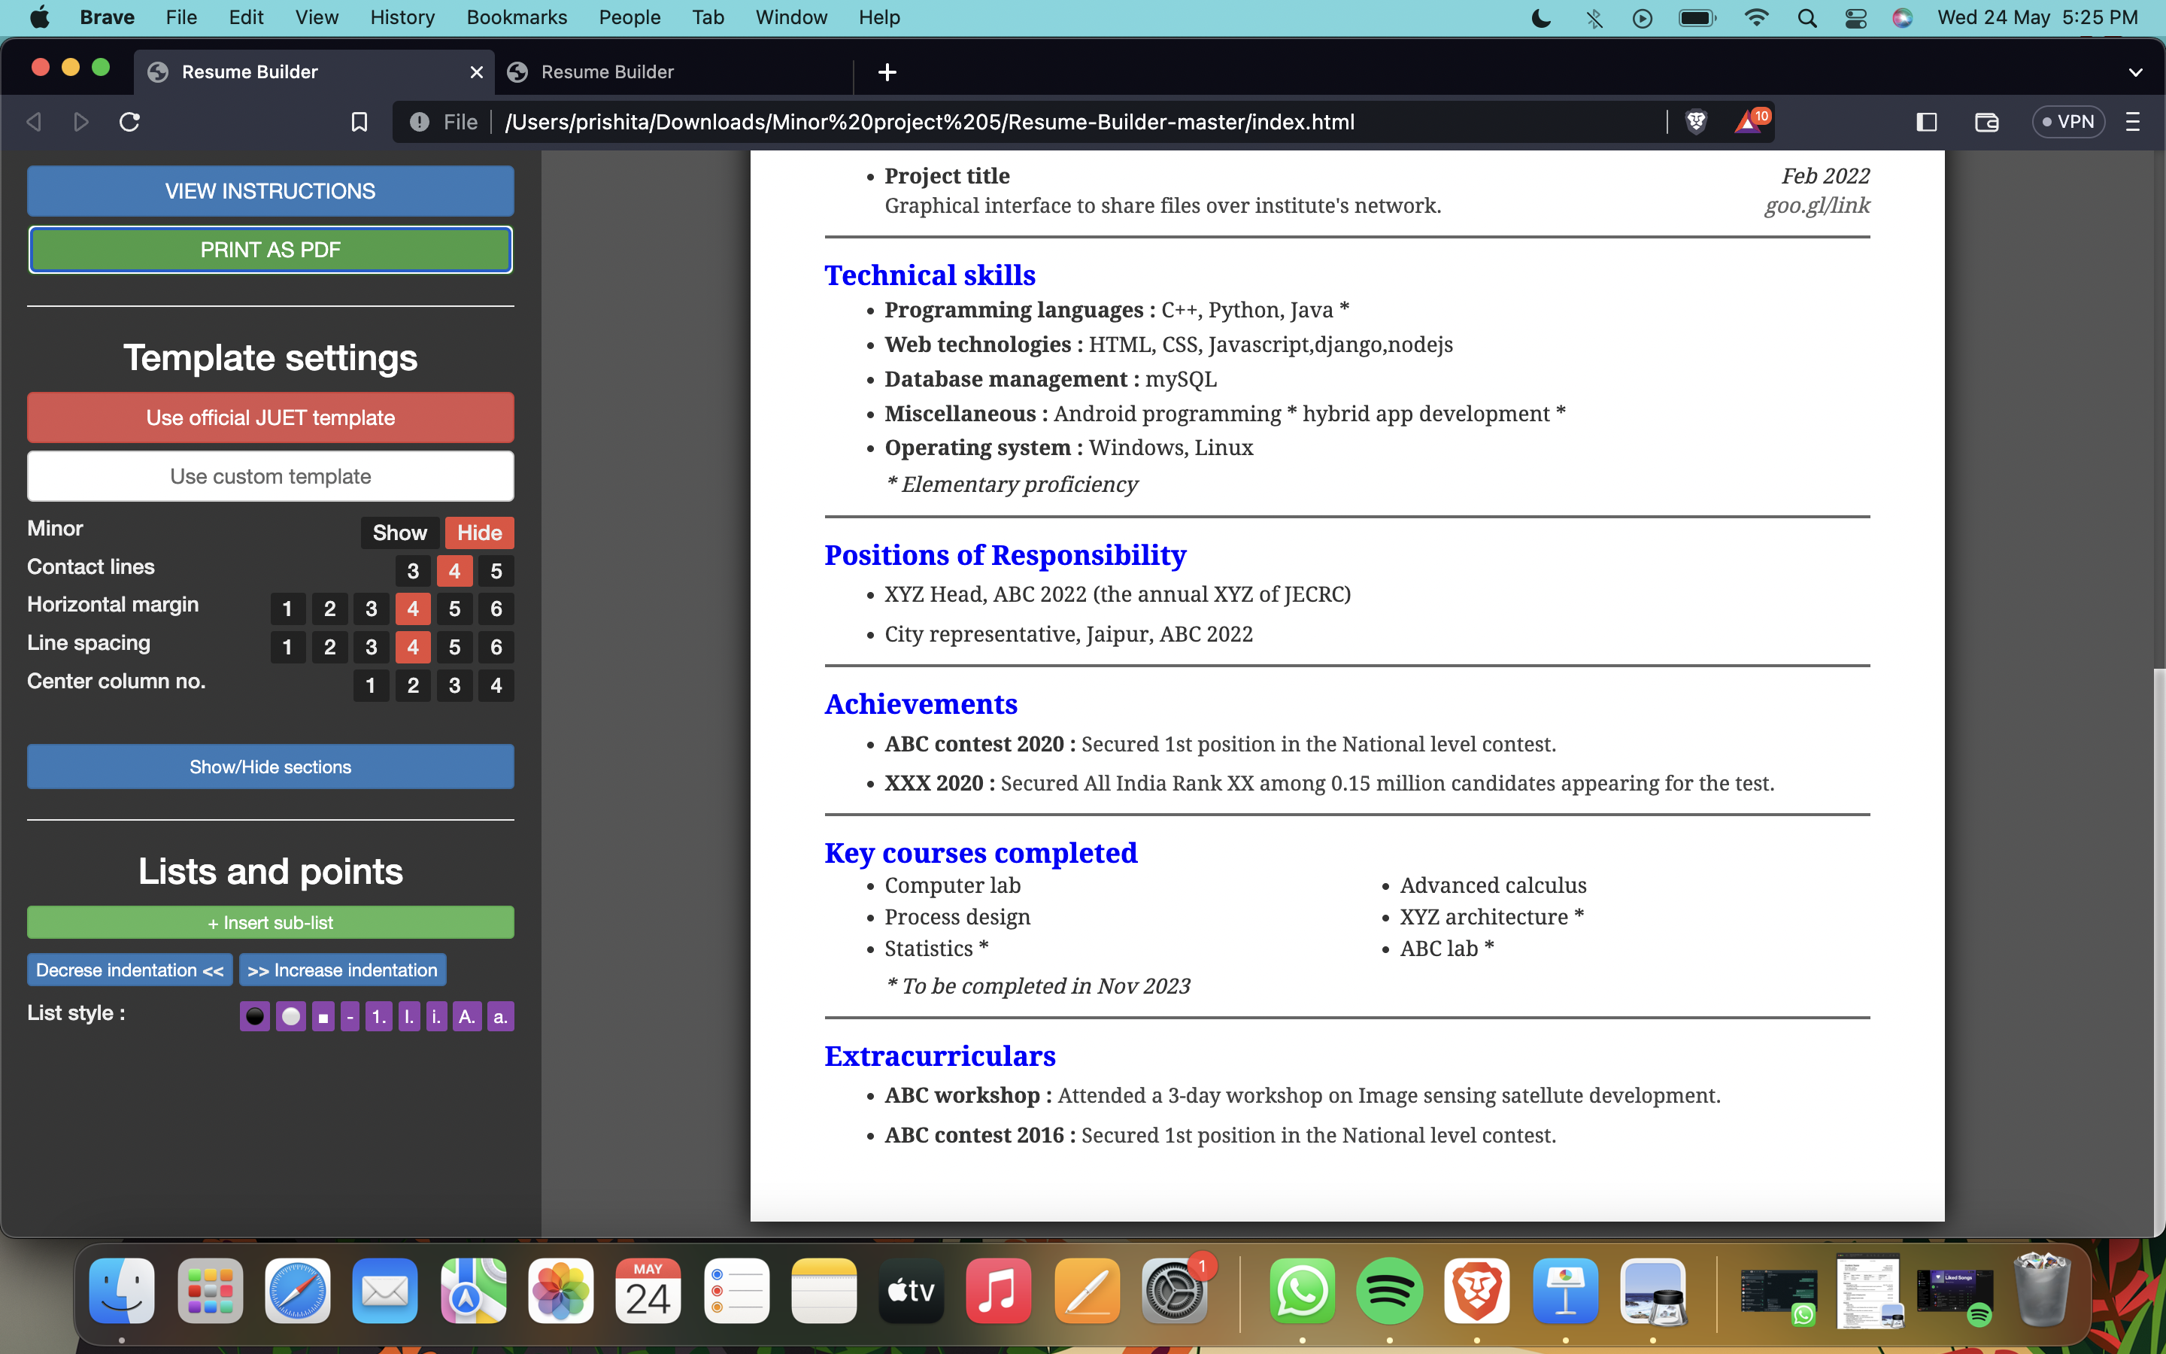

Slide 15
BENEFITS
Non-writer - The simplest effective tool for writing resume, specifically designed for non- writer’s.
Professional look - The resume provides professional for inexperienced job seeker’s.
Easy storage - our resume takes minimal space in storage devices and can be kept anywhere.

Slide 16
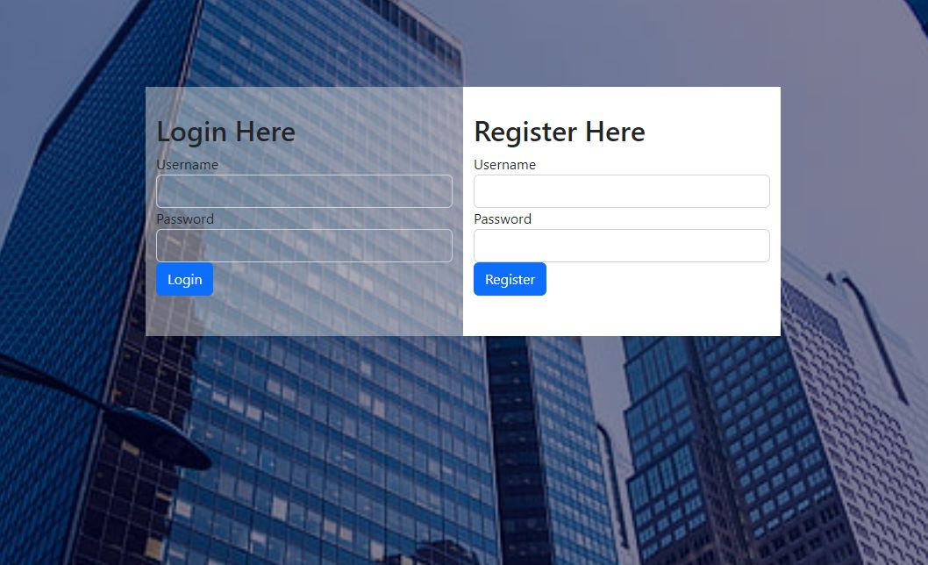
CREATE YOUR RESUME IN 3 SIMPLE STEPS
LOGIN WITH YOUR GMAIL ID
ALREADY REGISTERED THAN SIGN IN WITH YOUR REGISTERED ID

Slide 17
CREATE RESUME
ENTER DATA
BASIC INFO
EDUCATION
PROJECT
WORK EXPERIENCE

Slide 18

CREATE RESUME
AFTER CREATING RESUME LOGOUT.
LOGIN WHENEVER YOU WANT

Slide 19
CREATE FINAL RESUME
DOWNLOAD INTO ANY OF TWO FORMATS : *pdf, *txt.

Slide 20
OUR TWO PAGE RESUME OUTPUT LOOKS LIKE THIS

Slide 21
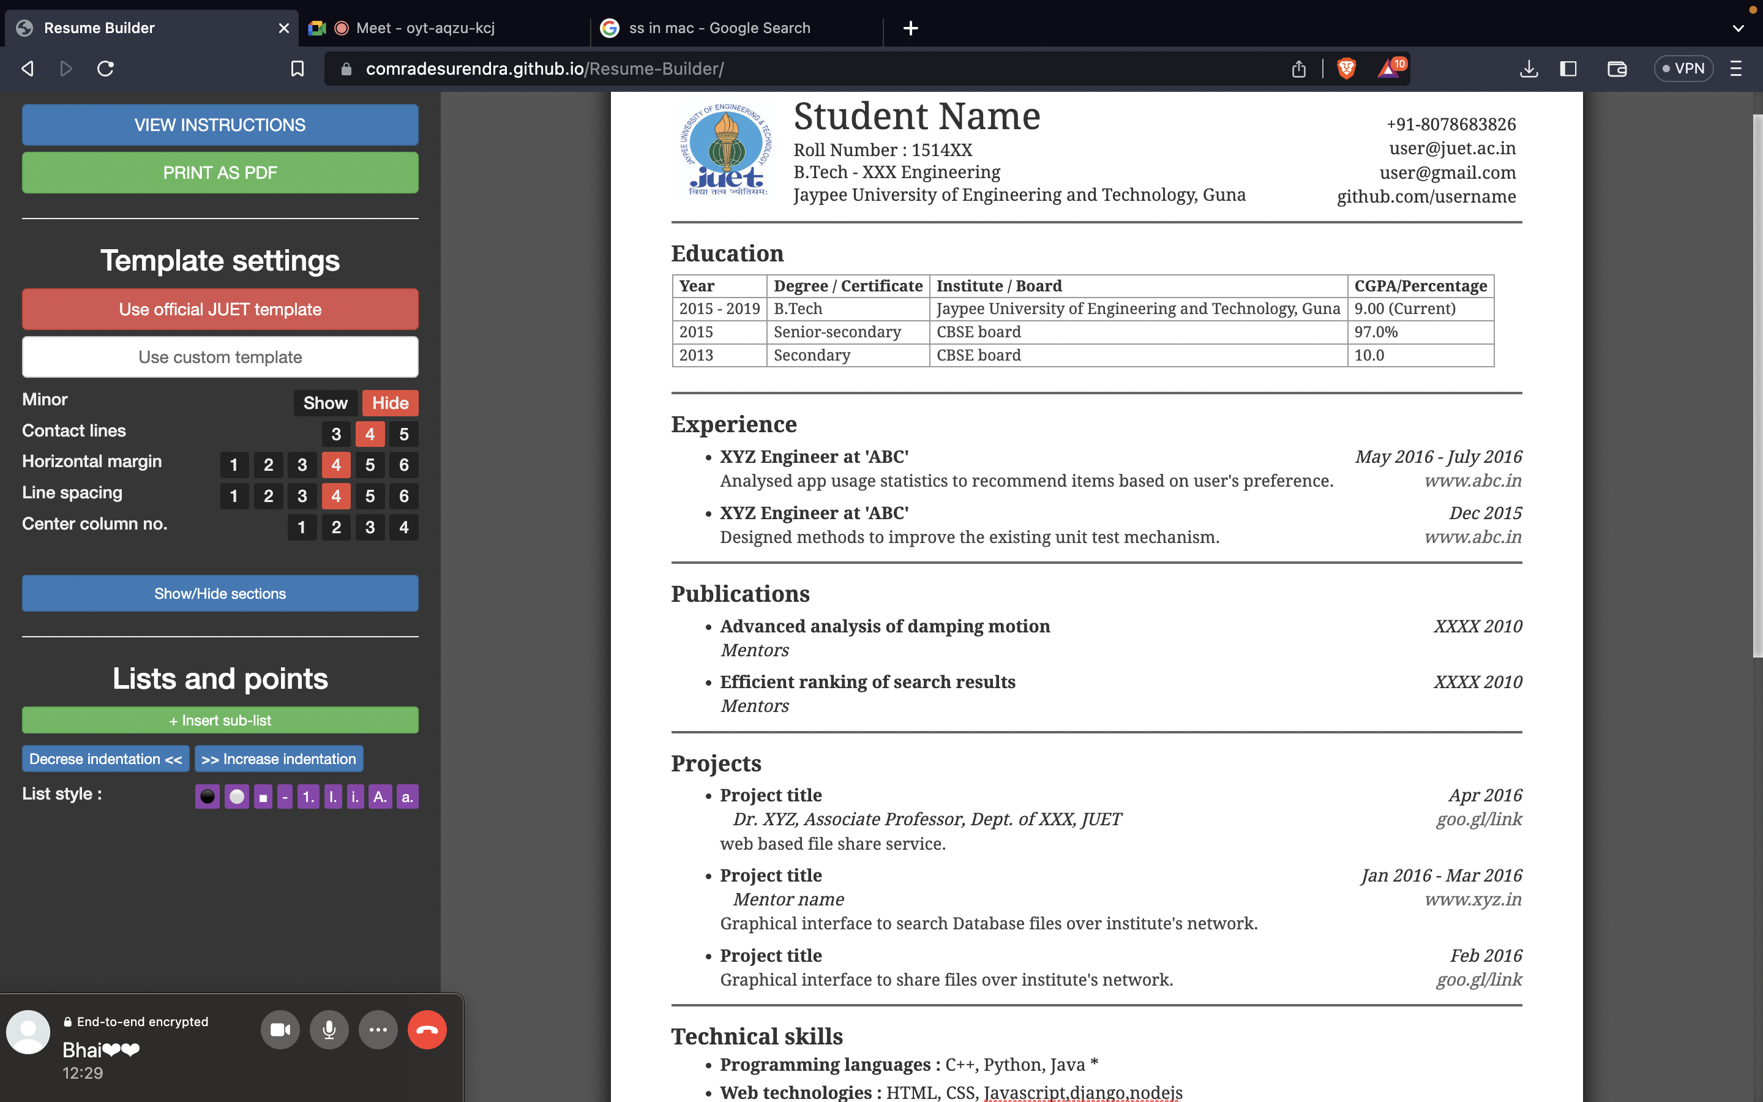

Slide 23
CONCLUSION
The online resume builder is one of the most fantastic systems for the people who are either recently graduated students in their domain or if they don’t have time to create the resume of good designs or patterns, then this platform is a very productive place for them. Analytical resume builder will analyse the material and course which they cam ppt for which will be more useful to them in their placements in future. It will be a clear path and guide which will make their decision much more easy and effective. There will be a less chance of regretting and wasting their time on different sources which are not worth it.

Slide 24
THANK YOU

